Slide 1
E R MODEL
Unit 2 Day 5

Slide 2
General Guideline
© (2021) ABES Engineering College.
This document contains valuable confidential and proprietary information of ABESEC. Such confidential and proprietary information includes, amongst others, proprietary intellectual property which can be legally protected and commercialized. Such information is furnished herein for training purposes only. Except with the express prior written permission of ABESEC, this document and the information contained herein may not be published, disclosed, or used for any other purpose.

Slide 3
Topics Covered
Day 6
Day 7
Day 8
Day 5
Introduction Case Study-User Requirement
Basic Concept of ER Model
ER Modelling
Entities
Attributes
Relationship
Extended ER Concept
Constraints on Binary Relationship Types
Keys
Completion of E R Diagram
Reduction of an E R Model to Relational tables
Reduction of an E R Model to Relational tables (Cont.)
Complete Relational Model of Case Study

Slide 4
Session Plan - Day 5
Database Schema
Conceptual schema
Logical schema
Physical schema
External level schema/View level schema/Subschema
ER Modelling
Entities
Relationship
Attributes

Slide 5
Module Objective
Describe use and apply data analysis and Modelling Techniques i.e. data modelling
To apply Binary Relationship Constraints
Describe the fundamental Elements of ER Model
To understand the concept of Keys
To Explain the Extended E- R concepts
Convert the ER model to relational table in populated relation database

Slide 6
Introduction to Database Schema

Slide 7
Introduction
Software applications are created to manage data and to help transform data into information.
A database design is an essential component of any application development .
Database designing is a necessary step in the process of creating any complex software.

Slide 8
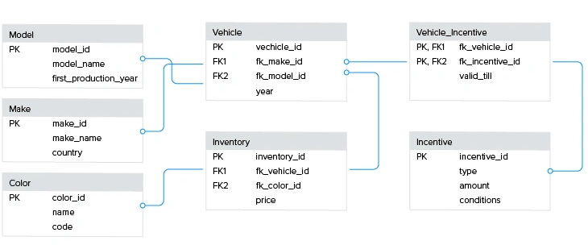
Database Schema
The overall design of the database of an organization is called a schema.
Database schemas are the blueprints that help developers visualize how databases should be built.
Example – Vehicle Schema
In the given example , a schema has been represented in a diagram for vehicle sales

Slide 9
Data Abstraction
Data Abstraction refers to the process of hiding irrelevant details from the user.
Example: When we send mail through Gmail , we need not to know the details of the server located. This detail is irrelevant for the mail sender.
Data Abstraction is divided into 3 levels to achieve Data Independence.
Data Independence means users and data should not directly interact with each other.
Three levels of Data Abstraction are:
View level
Conceptual Level
Physical Level

Slide 10
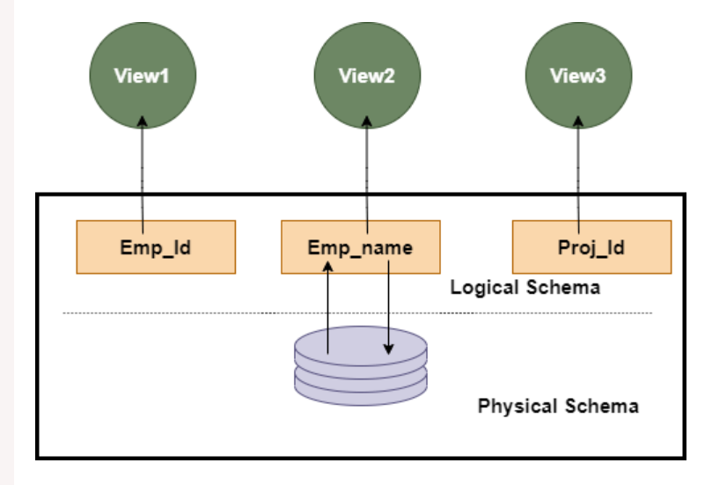
Schema at different levels
The schemas defined at various level of Data Abstraction are:
Conceptual schema
Logical schema
Physical schema
External level schema/View level schema/Subschema

Slide 11
Conceptual Schema
The conceptual schema design provides:
high-level data model.
a conceptual framework to specify the data requirements of the database users
how the database will be structured to fulfil these requirements.
Conceptual schema or conceptual data model:
The schema/model developed at the conceptual design phase provides a detailed overview of the enterprise.
It describes:
the things of significance to an organization (entity types),
its characteristics (attributes),
the associations between pairs of those things of significance (relationships).
Ex: ER Model

Slide 12
Logical Schema
It is a database design at conceptual level of the data abstraction
In Logical Schema Design:
The conceptual schema is transformed from the high-level data model into the implementation data model.
It defines how the database should be implemented using a specific DBMS.
This schema defines all the logical constraints that need to be applied to the data stored in the database.
Steps:
Select Data Model ; ex: Relational , Object , Network , Hierarchical etc.
Transform Conceptual Model into selected Data Model ex: ER to Relational
Implement all constraints as per selected data model.

Slide 13
Physical Schema
Physical Schema is the database design at the physical level of data abstraction.
It describes how the data is organized in files, internal storage structure, and access paths.
The logical schema is mapped to the physical schema using DBMS tools selected as per selection of data models in logical schema phase.
For Example : For RDMBS tools like Microsoft SQL Server, Oracle SQL, or IBM's DB2 etc.

Slide 14
View Schema or External Schema
It defines the design of the database at the view level of the data abstraction.
It defines how an end-user will interact with the database system.
There are many view schema for a database system. Each view schema defines the view of data for a particular group of people.
It shows only those data to a view group in which they are interested and hides the remaining details.
Example: For Car seller , only selling details are available at view level
For HR , only employee information is available at view level

Slide 15
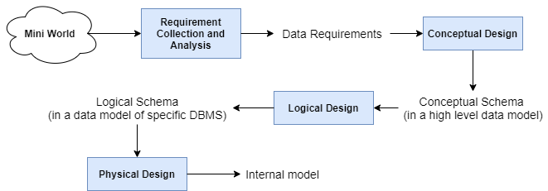
Data Modelling Process
Data modeling is a technique to define and organize the data requirements of an enterprise.
The process of data modelling is represented in the diagram:

Slide 16
Can you answer ?
Q. ____________ means to hide certain details of how data is stored and maintain.
Data Isolation
Data Integrity
Data Abstraction
None of these

Slide 17
Can you answer ?
Q. In data abstraction which is lowest level of abstraction ?
Physical Level
Conceptual Level
View Level
None of these

Slide 18
Can you answer ?
Q. ______ of abstraction explains how data is actually stored and describes the Data Structure and Access methods used by database.
Conceptual Level
Physical Level
View Level

Slide 19
Can you answer ?
Q. There are _________ levels of data abstraction.
A. 2
B. 3
C. 4
D. 1

Slide 20
Can you answer ?
Q. Which one is correct statement?
Logical data independence provides following without changing application programs:
(i) Changes in access methods.
(ii) Adding new entities in database
(iii) Splitting an existing record into two or more records
(iv) Changing storage medium
(A) (i) and (ii) (B) (iv) only
(C) (i) and (iv) (D) (ii) and (iii)

Slide 21
ER Modelling Introduction
The entity-relationship (ER) data model is based on a perception of a real-world that consists of a collection of basic objects, called entities, and of relationships among these objects.
Entities are described by a set of attributes.
The entity-relationship (ER) data model describes data as entities, attributes and relationships
The database design created using these graphical symbols is referred to as Entity-Relationship Diagram or E-R Diagram or simply ERD.

Slide 22
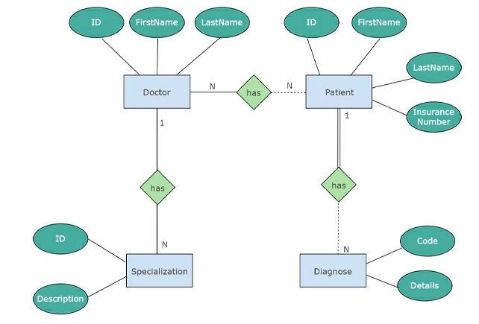
ER Modelling Introduction
Example of a ER Diagram showing Entity , Attribute and Relationship

Slide 23
Entities
An entity is a real-world object which can be a person, place, or thing that can be uniquely identified and distinguished from other objects.
Example : Student , Department , Country , Car , Course etc.
Entities are of two type:
Tangible: That exist in the real world physically, e.g., STUDENT, CAR, etc.
Intangible: That exist only logically and have no physical existence, e.g., COURSE, DEPARTMENT, etc.
In ER Diagram entities represented in RECTANGLULAR BOX
Example : Student Entity Car Entity
Student
Car

Slide 24
Entity Type
An entity type defines the set of entities having a common set of attributes.
Each entity type is defined by its name and attributes.
Example: All the students in a college or university will have the same set of attributes, then STUDENT becomes entity type.

Slide 25
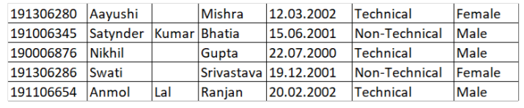
Entity Set
The collection of entities of a particular entity type in the database is called an entity set at any point in time.
It is also called the extension of the entity type.
Example:
Entity Type: STUDENT
Entity Set:

Slide 26
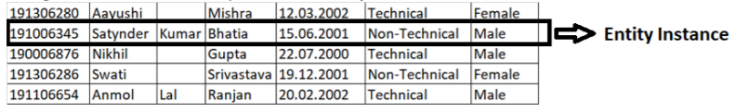
Entity Instance
A single occurrence of an entity is called an entity instance.

Slide 27
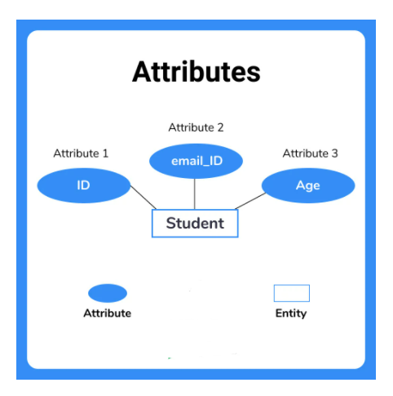
Attributes
Every entity has a set of properties that describes the entity.
For example, a student can have attributes like roll number, first name, middle name, last name, date of birth, gender.
Attributes are represented in oval shape attached to the entity.

Slide 28
Types of Attributes
The attributes of an entity can be different types:
General Attribute or Attribute
Key Attribute
Multivalued attribute
Composite Attribute
Derived Attribute

Slide 29
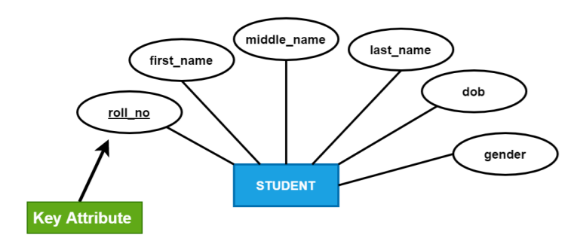
Types of Attributes (Cont.)
Key Attributes -
The attributes which help in the unique identification of entities are called key attributes.
Such attributes have unique values, e.g., roll_no of a STUDENT, course_id of a COURSE, and dept_id of a DEPARTMENT are the key attributes.
While representing such attributes, we need to underline them.

Slide 30
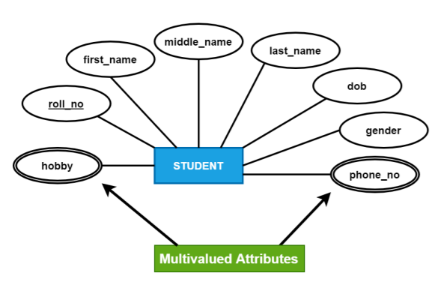
Types of Attributes (Cont.)
Multivalued attribute –
The attribute which can have multiple values for an entity type is called a multivalued attribute.
Example: A STUDENT can have multiple phone numbers using attribute phone no.
Use double line oval to represent the multi-values attribute.

Slide 31
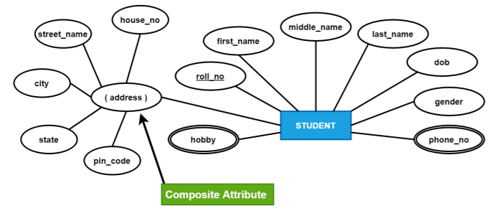
Types of Attributes (Cont.)
Composite Attribute –
An attribute composed of multiple sub-attributes is called a composite attribute. Example: The address attribute can be divided into five sub-attributes house_no, street_name.
Use rounded brackets to represent such attributes inside the oval shape.

Slide 32
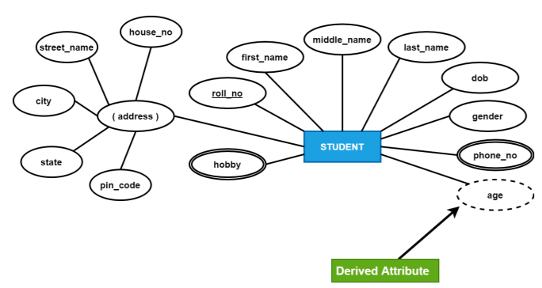
Types of Attributes (Cont.)
Derived Attribute –
An attribute whose value is calculated from another attribute(s) is called a derived attribute,
Example: age attribute can also be derived from another attribute, dob (date of birth).
Use dotted line oval shape to represent a derived attribute.

Slide 33
Can you answer ?
Q. ER modeling is primarily used for _________.
Database Programming
Organizing Databases
Designing Databases
None of the above

Slide 34
Can you answer ?
Q. Entity is a _________
Object of relation
Present working model
Thing in real world
Model of relation

Slide 35
Can you answer ?
Q. An Entity Set is
a set of entities of the same type that share the same properties
a set of entities of different type that share the same properties
a set of entities of different type that share the different properties
None of the above

Slide 36
Can you answer ?
Q. An attribute which can have many values for a single entity is called as
Composite Attribute
Descriptive Attribute
Derived Attribute
Multivalued Attribute

Slide 37
Can you answer ?
Q. Which of the following can be a multivalued attribute?
Phone_number
Name
Date_of_birth
All of the mentioned

Slide 38
Can you answer ?
Q. The attribute name could be structured as an attribute consisting of first name, middle initial, and last name. This type of attribute is called
Simple attribute
Composite attribute
Multivalued attribute
Derived attribute

Slide 39
Can you answer ?
Q. The first step in database design is
Physical Database Design
Logical Database Design
Conceptual Database Design
Requirements Gathering and Analysis

Slide 40
Type of Entity Types
Entity Type can be of two types:
Regular (Strong) Entity Type
Weak Entity Type

Slide 41
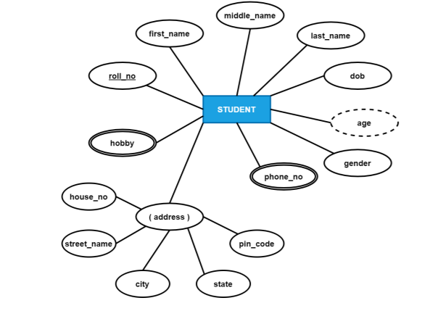
Strong Entity Type
Strong Entity Type are those entity types that have a key attribute(s).
A rectangle in the ER diagram represents a strong entity type.
Representation of Strong Entity (STUDENT)

Slide 42
Weak Entity Type
An entity type may not have a key attribute(s) to uniquely identify each entity instance. Such an entity type is termed as a weak entity type.
Example : Section (As section does not have its own key attribute) , so section is a weak entity set.
Weak Entity must be associated with another entity type, called the identifying or owner entity type.
Example: Department is the owner/identifying entity type of Section
A weak entity type has a partial key, which is the attribute that can uniquely identify weak entities that are related to the same owner entity.
Example: Section_name is the partial key of the Section weak entity as a section name uniquely identifies one single section for that department.

Slide 43
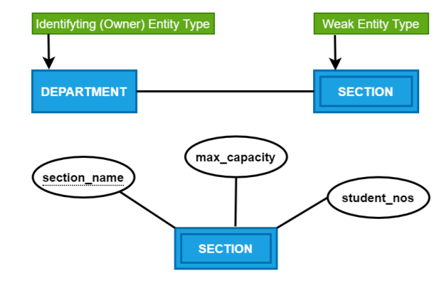
Weak Entity Type (Cont.)
Representation of Weak Entity in ERD:
A double outlined rectangle represents a weak entity type.
The partial key is represented by a dotted underline
Example: Section and section_name in the diagram
Representation of Weak Entity (SECTION)

Slide 44
Can you answer ?
Q. An entity type whose existence depends on other entity type ________.
Strong
Weak
Dependent
Variant

Slide 45
Can you answer ?
Q. Weak entity set is represented as
Underline
Double line
Double diamond
Double rectangle

Slide 46
Can you answer ?
Q. For a weak entity set to be meaningful, it must be associated with another entity set, called the
Identifying set
Owner set
Neighbour set
Strong entity set

Slide 47
Relationship
When two or more entity types are linked together to manage the related information, such linkage is called relationship.
Example: Every STUDENT belongs to a DEPARTMENT. These two entities have a relationship.
Use a diamond symbol to create the relationship between the entity types.

Slide 48
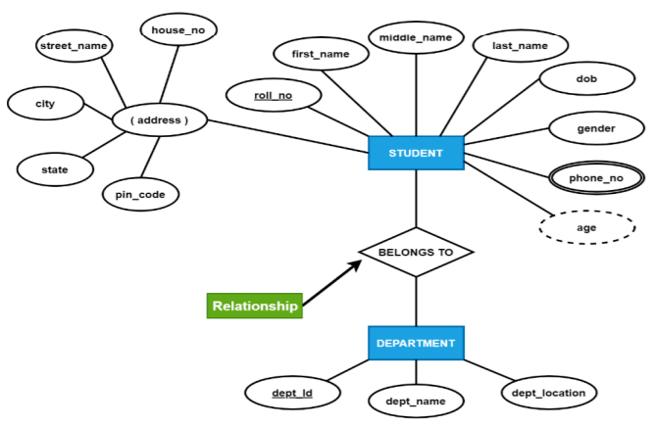
Relationship (Cont.)
Representation of Relationship (BELONGS TO)

Slide 49

Relationship Type
When two or more entity types are linked together to manage the related information, then such linkage is called a relationship type.
Example: Every STUDENT belongs to a DEPARTMENT. These two entities have a relationship type – "BELONGS TO“
Use the diamond symbol to create the relationship type between the entity types.

Slide 50
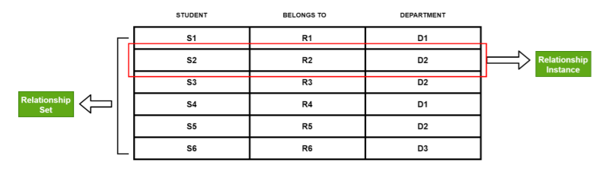
Relationship instance and a Relationship Set
A relationship instance is an instance that associates an entity instance from an entity type to another entity instance of another entity type to establish a relationship among various participating entity types.
A relationship set is the set of all relationship instances that participates in any relationship type to define a relationship between various participating entity types.

Slide 51
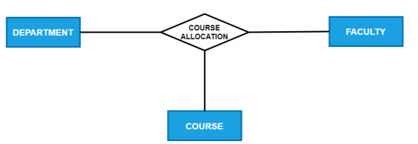
Relationship Degree
The degree of a relationship type is the number of participating entity types. Hence, the BELONGS TO relationship is of degree two has only two participating entity types, i.e., STUDENT and DEPARTMENT.
A relationship of degree two is called binary. A relationship type with degree three is called a ternary relationship.
ER diagram with a ternary relationship (COURSE ALLOCATION)

Slide 52
Role Names and Recursive Relationships
The role name signifies the role that a participating entity from the entity type plays in each relationship instance and helps to explain what the relationship means.
Example- In the BELONGS TO relationship type, STUDENT plays the role of a student, and DEPARTMENT plays the role of an academic department.
The role name becomes essential when the same entity type participates more than once in a relationship type in different roles.
Such relationship types are called recursive relationships.

Slide 53
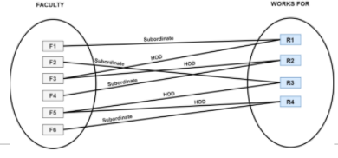
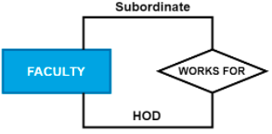
Role Names and Recursive Relationships (Cont.)
Example:
The WORKS FOR relationship type is a recursive relationship type.
It relates HOD and faculty entity type.
HOD and faculty entities are members of the same FACULTY entity set.
The faculty entity type participates twice in WORKS FOR, once in the role of a FACULTY and other in the role of a HOD.

Slide 54
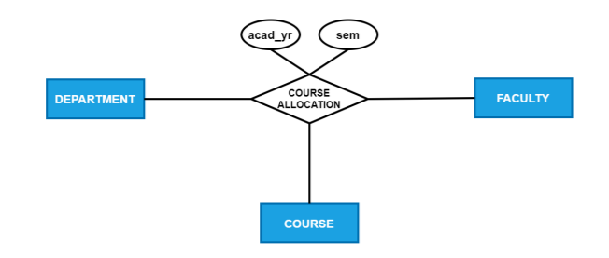
Attribute attached to a relationship type
A relationship type can also have attributes attached with it which are called descriptive attributes.
ER diagram of attribute attached with to a relationship type

Slide 55
Can you answer ?
Q. A relationship is an association between
Two or more Entities
One or more Entities
Entities and Attributes
One or more Attributes

Slide 56
Can you answer ?
Q. The function that an entity plays in a relationship is called that entity’s _________
Participation
Position
Role
Instance

Slide 57
Can you answer ?
Q. We indicate roles in E-R diagrams by labeling the lines that connect ___________ to __________
Diamond , diamond
Rectangle, diamond
Rectangle, rectangle
Diamond, rectangle

Slide 58
Thank You

